Slide 1
Jadcup Digital Twin Factory Automation
Team and roles
Joshua Ladowsky – Service Request Manager/Project Leader
Myles Hosken – Service Delivery Manager/Developer
Yeran Edmonds - Developer
Harshil Patel - Developer
Jane Jung - Developer

Slide 2
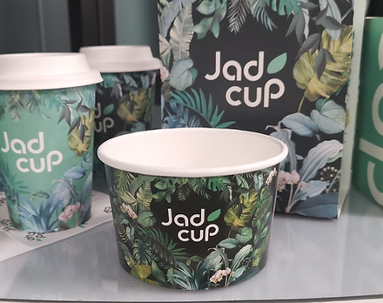
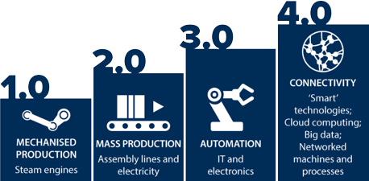
Project Background
Jadcup Sustainable and compostable cup manufacturer
How will we improve?
Internet of things
Cloud computing
Digital Twin
Notes:
Jadcup is a leader in sustainable cup production in New Zealand. They have recognized that their current manufacturing process, which utilizes automation, information technology, and electronics, has room for improvement. This current process is what is known as Industry 3. We aim to improve the process by transitioning to Industry 4 by augmenting the existing system with the Internet of Things, Cloud Computing, and a Digital Twin. The Internet of Things will enable the installation of low-cost sensors on each machine, connecting them to a network, while Cloud Computing will facilitate machine communication and provide a secure database for storing credentials and data. Additionally, a Digital Twin will be created to simulate the factory floor and production process, allowing for testing and implementation of changes before they reach the factory. The goal is to modernize Jadcup’s operations and usher in Industry 4 capabilities, elevating the company's position within the sustainable cup manufacturing sector. Now onto project scope ☺

Slide 3




Project Scope
Objective
FERN JavaScript Technology
Develop a remote-monitoring system for Jadcup to interact with PLCs
Determine viability of a monitoring interface to manage Jadcup PLCs
Single-Language tech stack Flexible Frameworks Community Support Cost Effective
Scope
Requirements
Functional prototype to read and control PLC data
Working factory simulation to demonstrate system functionality
Must connect & control PLCs
Must contain factory simulation to demonstrate application
Must have simple interface that's user-friendly on PC
Must be contained within office Intranet and use principles of CIA for authentication & authorization
Notes:
This is a project
- create a remote-monitoring system
- determine the viability of our interface for Jadcup's PLCs
For our deliverables,
- MVP functional prototype
- Factory simulation digital twin
Tech Stack
- MEAN stack, LAMP stack, Java application, but chose FERN because of community & long-term support and using modern technologies
- Web Application
Requirements
- Fast, responsive
- Big simple buttons
- We're currently acting as if directly connecting to Jadcup's PLCs are out of scope, but we're likely to work it out throughout development

Slide 4
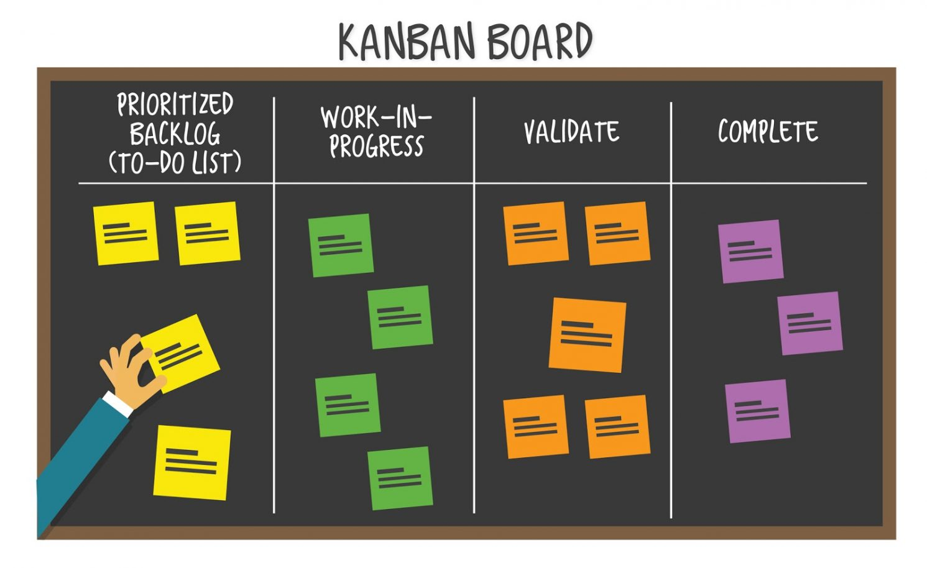
Project Methodology
Kanban
Agile framework
Good change philosophy
Focus on continuous work flow
Visual approach to manage task progression
Flow limit
Project Phases
Planning
Upskilling
Development/Monitoring
Closing
Review
Notes:
Agile = flexible development (waterfall lays out all tasks at once) which means tasks can be identified/changed as we go compared to waterfall which identifies all required tasks together Iterative approach allows teams to develop multiple tasks at once, which is useful when the project is essentially a network of different components. we can develop and test at the same time. Waterfall would mean we develop one component completely before starting another one which is inefficient if we can’t give a correct estimate of how long a task will take
Kanban’s change philosophy is ideal when adding/editing task’s requirements and as it focuses on the continuous flow of work, it’s better than scrum where the goal of a task is set to be completed by a set deadline within a sprint (we don’t know how to split tasks or how long a task will take. Visual structure of kanban allows everyone to keep track of the progress on a task anytime which is favourable if we consider our team doesn’t have a stable meeting schedule required for frameworks such as flow or agile. Flow limits are also used to make sure tasks are being completed evenly to pace ourselves
Key tasks- see kanban implementation appendix 6.2

Slide 5

Issues/Risks
Time scheduling
Most of us had full packed weekdays.
This made it quite difficult to put time into your project.
Spending time on Saturday morning work on the project.
Unclear requirements
Design and necessary features. Can be a major risks/problems.
Not being able to reach/communicate with the client.
Keep open and clear communication with the client's requirements .
Incorrect work performed
Performing incorrect work, doing uncertainty features or requirements.
Wasted in unnecessary areas which could have been spent doing more productive requirements.
Clarify work with the team, mentor, and client regularly.
Notes:
No established meeting time
Section 8- team schedule for part 1
Irregular schedule for client meetings
The client can only meet us once or twice during the semester, which reduces the amount of opportunities for face to face communication and may cause delays in responses
Unclear requirements at planning stage
Appendix 8.3 meeting minutes
Several components required for development all with different tech stacks
Appendix 5.1 skills matrix

Slide 6

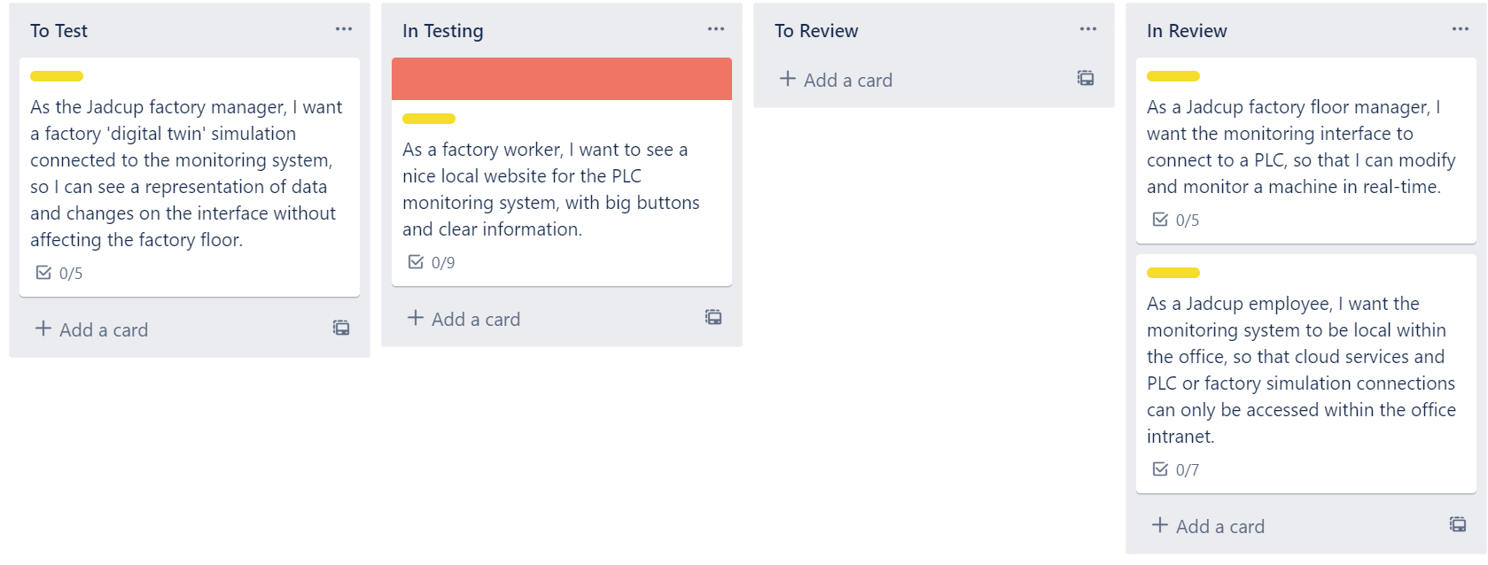
Quality Assurance
How do we detect issues?
How do we keep up QA standards?
Testing
Unit
Integration
Functionality
Code Walkthroughs
QA Metrics
Tests Per Card
Bug Per Card
Bug Distribution
Number of Tests
QA Matrix
Record of all QA results
Useful in analysing outcomes
QA With Kanban
Columns for each stage of testing
Failed Tests become expedited

Slide 7
Project Timeline
Planning
3/6/23- 4/7/23 (4 weeks)
Upskilling
4/10/23-4/23/23 (2 weeks)
Development and Monitoring
4/28/23- 9/24/23 (20 weeks)
Closing
9/25/23- 10/6/23 (1 week)
Review
Project proposal and presentation
Development/Monitoring of all required project components
Final review of all components
Project handover
10/9/23-10/27/23 (2 weeks)
Client & mentor feedback
Project poster presentation
Project Portfolio
Notes:
Appendix 8.2

Slide 8
Post-Proposal – Upskilling Plan
Learn Kanban Methodology
Discover and Analyse Project Requirements
Delegate & plan user story tasks
Technology Field | Infrastructure Lead | Secondary Lead
FactoryIO/PLC | Josh | Yeran
Backend | Yeran | Myles
Frontend | Harshil | Jane
UI | Jane | Josh
Server/Database | Myles | Harshil

